Slide 1


Civil Rights Training
Commodity Supplemental Food Program (CSFP)
The Emergency Food Assistance Program (TEFAP)
California Department of Social Services

Slide 2



Agenda
Definition
Regulations and Authorities
Civil Rights Training
Racial and Ethnic Data Collection
Protected Classes
Complaint process
Sample Scenario
Notes:
This training will cover the following:
The Definition of Civil Rights
The Regulations and Authorities which govern Civil Rights
Training requirements
Racial and Ethnic Data Collection for the CSFP Program
Protected Classes, accommodations
The Complaint process
And some Sample Scenarios

Slide 3
Training Objectives
Recognize and Prevent
Understand CR Procedures
Identify LEP Requirements
Accommodate 4 Disabilities
Record Keeping
Notes:
As a result of participating in this training, you will be able to:
Recognize and prevent discrimination based on any of the protected classes.
Understand civil rights compliance procedures.
Identify the assistance requirements for people with Limited English Proficiency (LEP).
Understand how to accommodate people with disabilities.
And Finally understand the requirements for record keeping

Slide 4

What are Civil Rights?
Civil Rights are the rights of individuals to receive equal treatment (and to be free from unfair treatment or discrimination) based on certain legally protected classes.
Notes:
What are Civil Rights?
The rights of individuals to receive equal treatment
To be free from unfair treatment based on certain legally protected classes.
Civil Rights are the rights of personal liberty
guaranteed to US citizens by the 13th and 14th Amendments of the Constitution and Acts of Congress.

Slide 5



Elements of Civil Rights training
CSFP & TEFAP receive federal $$$$
Must be annual
Process for Complaints
Notes:
Why is this Training Required
TEFAP and CSFP receive federal funding from the United States Department of Agriculture (USDA).
Therefore required to demonstrate compliance with federal civil rights requirements.
How Often should training be offered?
Annually
New Process effective 2018
Food Banks Must create a system for responding to client complaints on the basis of perceived or actual discrimination.
*Completion of this training meets these obligations.

Slide 6

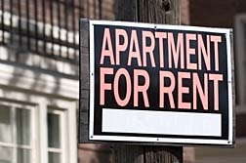




Civil Rights Legal Authorities
Notes:
The Civil Rights Act of 1964
Made it illegal to discriminate on the basis of race, color, religion, sex or national origin
The Civil Rights Act of 1968
provided equal housing opportunities regardless of race, color, religion, sex, disability, familial status, or national origin.
The Americans with Disability Act (ADA)
prohibits discrimination against individuals with disabilities in all areas of public life.
Section 504 and 508 of the Rehabilitation Act
Offers protection to people with disabilities
Requires that Federal agencies make their electronic and information technology accessible to people with disabilities
Title IX of the Education Amendments Act of 1972
prohibits discrimination based on sex under any education program
The Age Discrimination Act of 1975
prohibits discrimination based on age

Slide 7

What is Discrimination?
Different treatment of one person or a group of persons from others; either intentionally, by neglect, or by the actions or lack of actions based on the protected classes.
Notes:
What is discrimination?
The Different treatment of one person or a group of persons from others;
intentionally,
by neglect,
or by the actions or lack of actions based on the protected classes.
Example of Discrimination
A Russian lady comes in to receive food and the volunteer sends them to the back of the line simply because she is Russian.

Slide 8




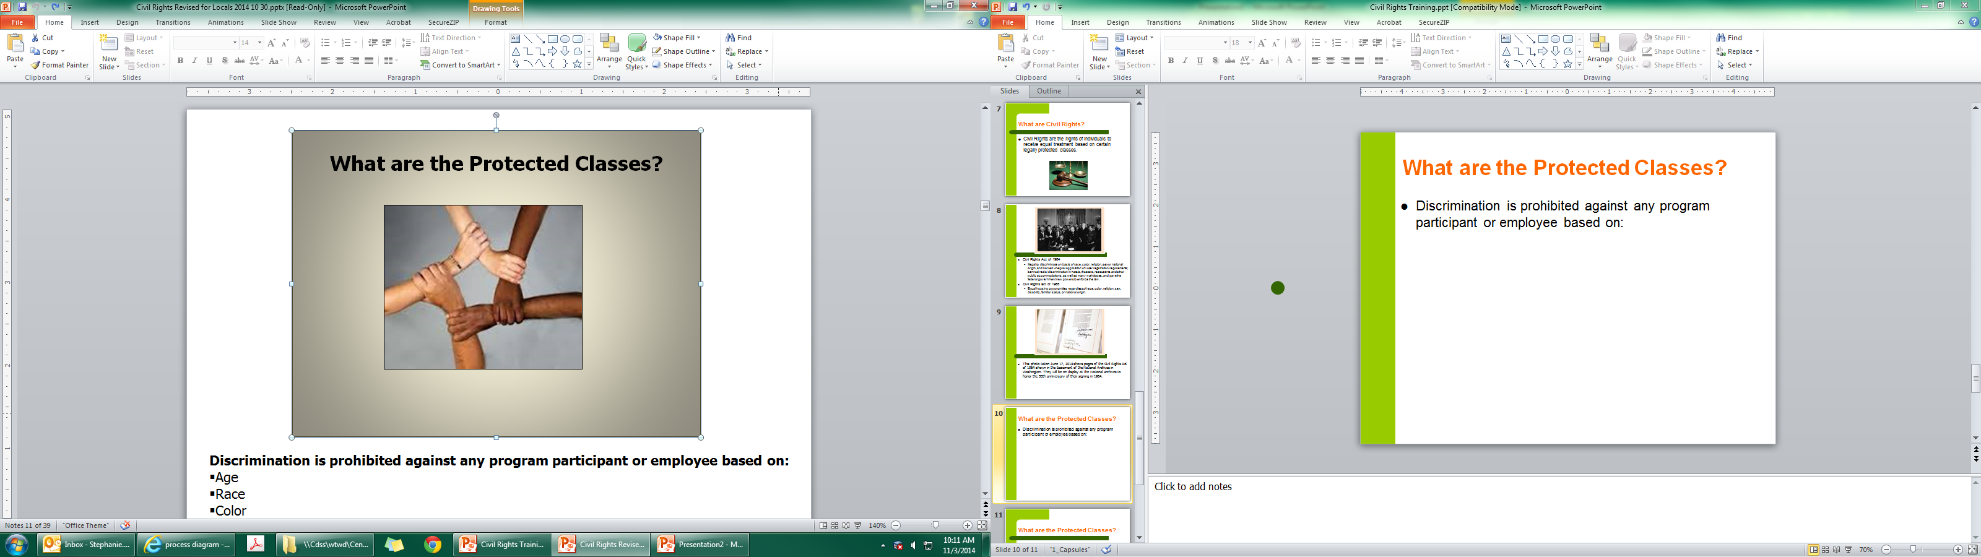
Protected Classes for our Program
Race
Color
Age
Sex
Disability
National Origin
Notes:
What are the protected classes for this program?
There are 6 federally protected classes within the CSFP and TEFAP programs.
Discrimination is prohibited against any program applicant or participant based on:
Race
Color
Age
Sex
Disability
National Origin

Slide 9


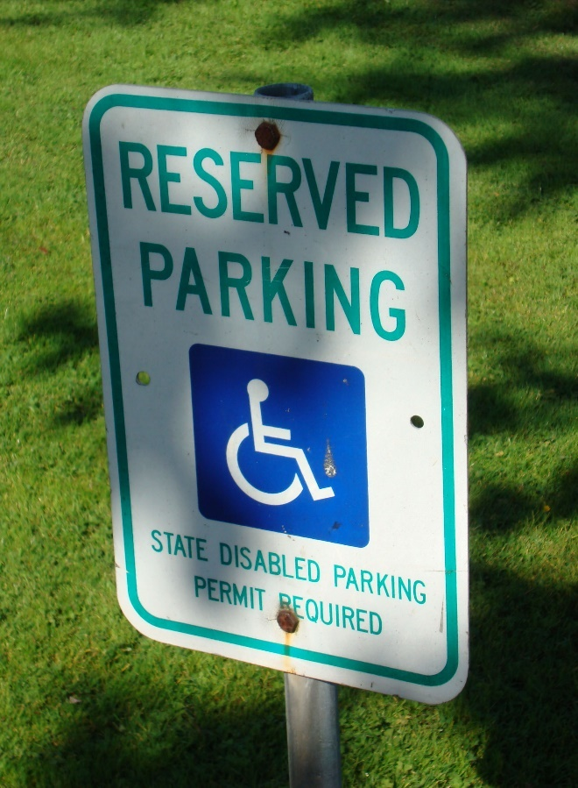
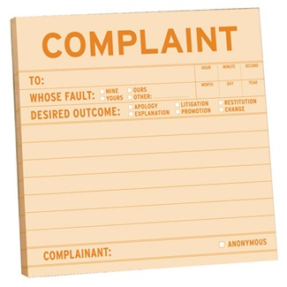
Examples of Discrimination
Notes:
Some examples of discrimination within the CSFP and TEFAP programs could include:
Refusal to announce the program publicly so that all eligible people are made aware of the program
Refusal to provide program information in languages other than English
Refusal to provide participants with information on how to file a complaint
Refusal to provide reasonable accommodations if necessary

Slide 10

Who Needs Civil Rights Information and training?
Food Bank program staff
Front Line Staff/Volunteers
Non-Frontline Staff/Volunteers
Notes:
Who needs to know about Civil Rights information?
Food Bank program staff
Front Line staff and volunteers
Non Frontline staff

Slide 11
Who does NOT need Civil Rights Information and training?
Staff who do NOT have contact with public
            AND
Do NOT handle personal info
Notes:
Who does NOT need civil rights training
Staff who do not handle personal information
Staff who do not have contact with the public

Slide 12

Who are Program Managers
Staff or Volunteers
  Manage TEFAP or CSFP program
  Food Bank or Site
Notes:
Who are Program managers?
Food Bank program staff that run the EFAP or CSFP program
Volunteers or employees at the sites who
Those that manage the program at the site even if they don’t have interaction with clients.

Slide 13
Frontline Staff
Volunteers or employee
  Interaction with applicants
  Handle personal information
  Have Frequent Contact
Notes:
Who are Frontline staff?
Volunteers or employee
Interaction with applicants
Handle personal information
Have Frequent Contact with participants

Slide 14
Non-Frontline Staff
Volunteers or employee
  Infrequent contact
    Two times or less per year
  Examples
    One time volunteers
    School or Church Groups,
Notes:
Who are the Non-Frontline staff?
Volunteers or Program staff who
Do not handle personal information for client
Have infrequent contact with clients/participants
Such as 2 times or less per year
One-time volunteers would also be considered non front line staff.
Example: church or school groups

Slide 15
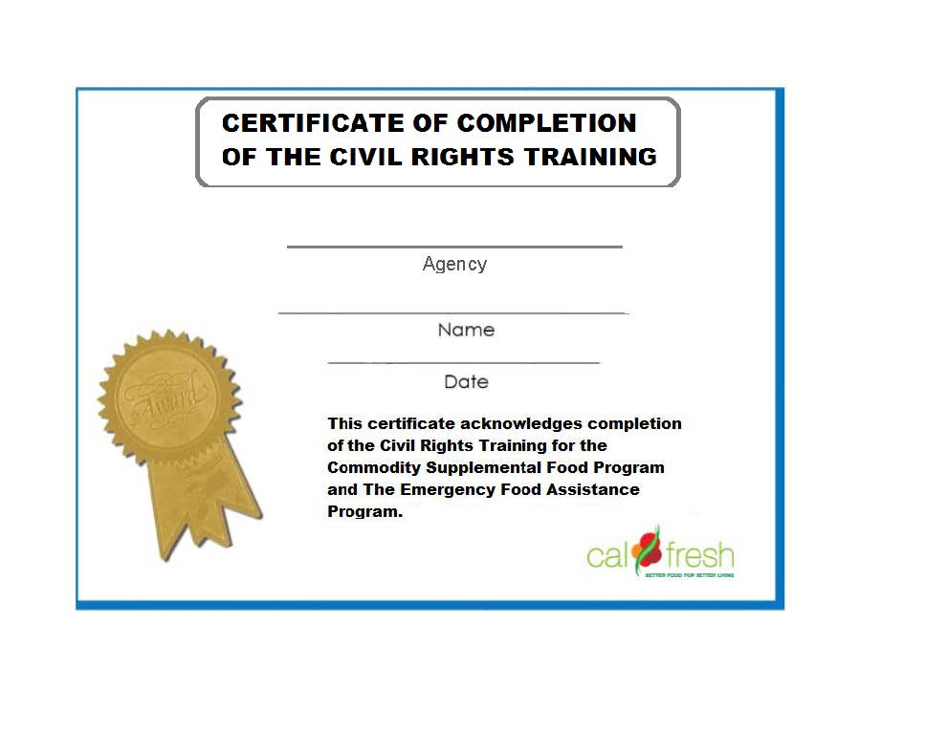

Civil rights Webinar
http://www.cdss.ca.gov/inforesources/EFAP/Policies-and-Notices
Notes:
The Civil Rights Webinar Option
There is an option to view a webinar at this website
Food Bank program managers and distribution site managers MUST use Webinar or in person training such as this
Must be conducted prior to contact with clients
If taking webinar
Make sure to go back to web page
Print Certificate
Give certificate back to Food bank
Maintain for 3 years plus the current year
Food Bank maintains the certificates or logs of completion NOT THE SITE
DON’T’ SEND TO CDSS FDU

Slide 16

How often? FRONTLINE
Annually
http://www.cdss.ca.gov/inforesources/EFAP/Policies-and-Notices
Notes:
How Often shall Frontline staff receive training?
Annually
Training may be one of these options
In person training like this
The Civil Rights Webinar
Civil rights checklist for front line staff
Must be conducted prior to contact with clients

Slide 17
Notes:
Front line Checklist Option
Front line staff (NOT Food Bank Program staff have the option:
To read and initial this checklist rather than do the webinar
Checklists with original signature must be maintained at the Food Bank for three years plus the current year
Must be conducted prior to contact with clients
Can find the webinar and checklists at
http://www.cdss.ca.gov/inforesources/EFAP/Policies-and-Notices)
TRANSLATIONS
AVAILABLE IN OTHER LANGUAGES THROUGH LARFB

Slide 18
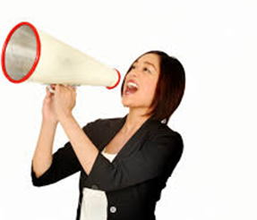
Public Notification
Program availability
Procedures for filing a complaint
Non discrimination information
And Justice For All Poster
Notes:
CSFP and TEFAP agencies must include a public notification system. The purpose of this system is to inform applicants, participants and eligible people of these programs.
What are the components of Public Notification
Announcing Program Availability
(informing participants and potentially eligible persons of their program rights and steps necessary for participation)
Ex: Not just telling your friends or a group of individuals about the program
Complaint Information must be available
Advising the participant of how to file a complaint of discrimination
Making sure that the non discrimination statement is included on all information materials
The USDA non discrimination And Justice for All poster must be prominently displayed where it can be viewed by the participants
Ex: the Poster should NOT be placed in a locked office away from clients

Slide 19
Nondiscrimination Statement
In accordance with Federal civil rights law and U.S. Department of Agriculture (USDA) civil rights regulations and policies, the USDA, its Agencies, offices, and employees, and institutions participating in or administering USDA programs are prohibited from discriminating based on race, color, national origin, sex, disability, age, or reprisal or retaliation for prior civil rights activity in any program or activity conducted or funded by USDA.
Persons with disabilities who require alternative means of communication for program information (e.g. Braille, large print, audiotape, American Sign Language, etc.), should contact the Agency (State or local) where they applied for benefits. Individuals who are deaf, hard of hearing or have speech disabilities may contact USDA through the Federal Relay Service at (800) 877-8339. Additionally, program information may be made available in languages other than English.
To file a program complaint of discrimination, complete the USDA Program Discrimination Complaint Form, (AD-3027) found online at: http://www.ascr.usda.gov/complaint_filing_cust.html, and at any USDA office, or write a letter addressed to USDA and provide in the letter all of the information requested in the form. To request a copy of the complaint form, call (866) 632-9992. Submit your completed form or letter to USDA by:
(1) mail: U.S. Department of Agriculture
Office of the Assistant Secretary for Civil Rights
1400 Independence Avenue, SW
Washington, D.C. 20250-9410;
(2) fax: (202) 690-7442; or
(3) email: program.intake@usda.gov.
This institution is an equal opportunity provider.
Notes:
This is the current “nondiscrimination statement” which includes information for how to file a complaint with the USDA. It lists all of the federally protected classes.
This same statement is available in Spanish and the language is included on the And Justice for All Poster
This entire unchanged statement must be included on all documents pertaining to CSFP and TEFAP including the participant application for CSFP.
Hard copies of this statement should be available at each site and food bank for participants to take with them should they need information on how to file a complaint

Slide 20





Nondiscrimination Statement Requirements
Notes:
The nondiscrimination statement is required on all documents pertaining to the CSFP and TEFAP. This is a list of documents that require the statement.
Participant Application
Education Materials
Employee Handbooks
Newsletters
Print or Broadcast
Advertisements
Brochures
Flyers
And Web Sites home page

Slide 21

SHORT Nondiscrimination Statement-
“This institution is an equal opportunity provider”
“Esta institución es un proveedor que ofrece igualdad de oportunidades” (Spanish)
Notes:
“This institution is an equal opportunity provider” is a Shortened non discrimination statement
Please remember that the nondiscrimination statement cannot be modified. However, this short version of the statement can be used only in the following instances: flyers, brochures, and pamphlets IF the document is a half page or less in length

Slide 22
Poster Posted
The USDA nondiscrimination poster "And Justice for All" must be prominently displayed in a place where it can be seen.
Notes:
The USDA non discrimination And Justice for All poster must be prominently displayed where it can be viewed by the participants
Ex: the Poster should NOT be placed in a locked office away from clients
.

Slide 23
Complaints of Discrimination
Age
Race
National Origin
Disability
Sex
Color
A civil rights complaint must be based on one or more of the following:
Notes:
Within theses programs a civil rights complaint is based on one or more of the following:
Age
Race
Color
Sex
Disability
National Origin
These complaints are investigated by the USDA

Slide 24
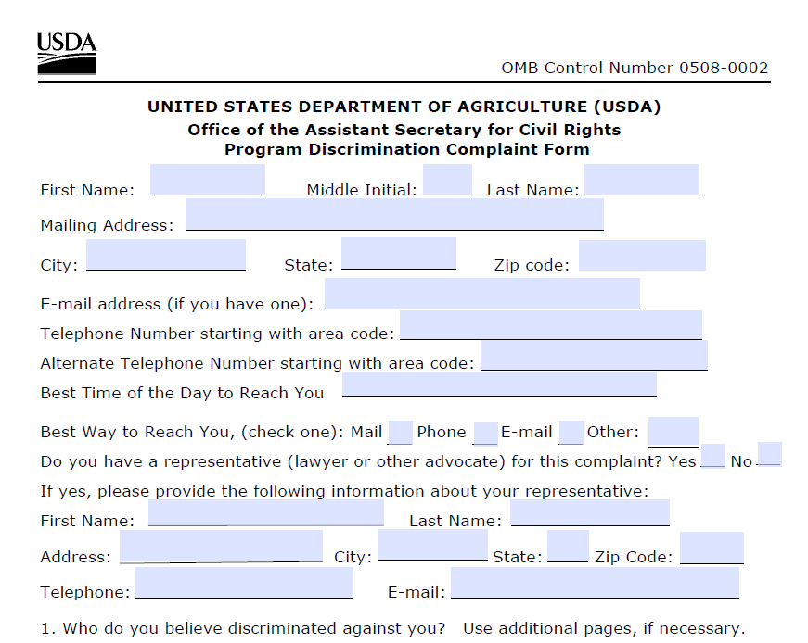
Program Discrimination Complaint Form
English
http://www.ocio.usda.gov/sites/default/files/docs/2012/Complain_combined_6_8_12.pdf
Spanish
http://www.ocio.usda.gov/sites/default/files/docs/2012/Spanish_Form_508_Compliant_6_8_12_0.pdf
Notes:
USDA developed complaint forms to streamline the way civil rights complaints are received. This was in order to achieve efficiency and consistency across all USDA agencies, not just FNS.
Currently the use of the forms are not mandatory, but highly encouraged since it captures all the required information that is needed in the initial stages of a complaint.
The individual must SIGN the complaint
NOT A REQUIRED FORM BUT USEFUL

Slide 25

Distribution Site Procedure for Complaints
Food Bank
Assign Civil Rights Coordinator
Have forms available
  Non discrimination
  Complaint forms
  Help or assist filling forms
  Provide FB Telephone
Notes:
The Distribution Sites must
Have forms available
Non discrimination statement handout
Blank USDA complaint forms
Food bank telephone number
Should help the site and participant with the process for filing a complaint with USDA

Slide 26


Food Bank Complaint Procedure
Assign a Complaint Coordinator
Create a complaint log
  Relevant Information
Keep three years
Assist in Filling out Form
Notes:
How to Handle a complaint:
The Food Bank complaint coordinator must ensure :
That the Food Bank is maintaining a complaint log
When aware of the complaint
Help participant fill out form if necessary and mail to USDA if necessary
Enter information into log (Must contain relevant information to resolve and investigate the complaint)
The log Must be maintained for three years plus the current year (even if a complaint was not made during that calendar year)
The Food Bank must notify the Food Distribution Unit with the California Dept of Social Services of the complaint,
The Site AND Food Bank must assist with the processing of complaints
Refer individual to the And Justice For All Poster
Provide a complaint form (printed from USDA)
Provide the individual with a copy of the non discrimination statement
Help them fill out form if necessary
site must inform Food bank of known complaint

Slide 27

What is Limited English Proficiency?
Individuals who do not speak English as their primary language and who have a limited ability to read, speak, write, or understand English.
Notes:
What is limited English Proficiency? (LEP)
Individuals who do not speak English as their primary language and have a limited ability to read, speak, write or understand English.
CSFP and TEFAP agencies must take reasonable steps to ensure meaningful access to their programs and activities by persons with limited English proficiency.

Slide 28

Limited English Proficiency (LEP)
These services may include:
  Providing interpreters or bilingual staff
  Providing printed materials in different languages
  Non Verbal Direction
When required
  Frequent contact = greater duty
你好
Здравствуйте
السلام عليكم
Hello
Ciao
Bonjour
God dag
Hola
Notes:
Food banks and distribution sites have a responsibility to take reasonable steps to ensure meaningful access to their program information and services by persons with (LEP.)
These services may include:
Providing interpreters and bilingual staff
And Providing printed materials in different languages
Could use printed materials with commonly used phrases.
When are LEP services needed? The rule of thumb for determining if LEP services are needed is the more frequent the contact with the particular language group, the more likely services are needed.
An Example: If an LEP individual accesses a program on a regular basis, then the site has a greater duty to provide increased solutions. Less frequent contact with different language groups may warrant a different and less intensified solution.

Slide 29


Americans with Disabilities Act (ADA)
What is it?
  prohibits discrimination against people with disabilities.
Who is protected by ADA?
  individuals with disabilities.
Notes:
What is the American’s with Disabilities Act?
Federal legislation that prohibits discrimination against people with disabilities.
Who is protected by ADA?
individuals with disabilities..

Slide 30
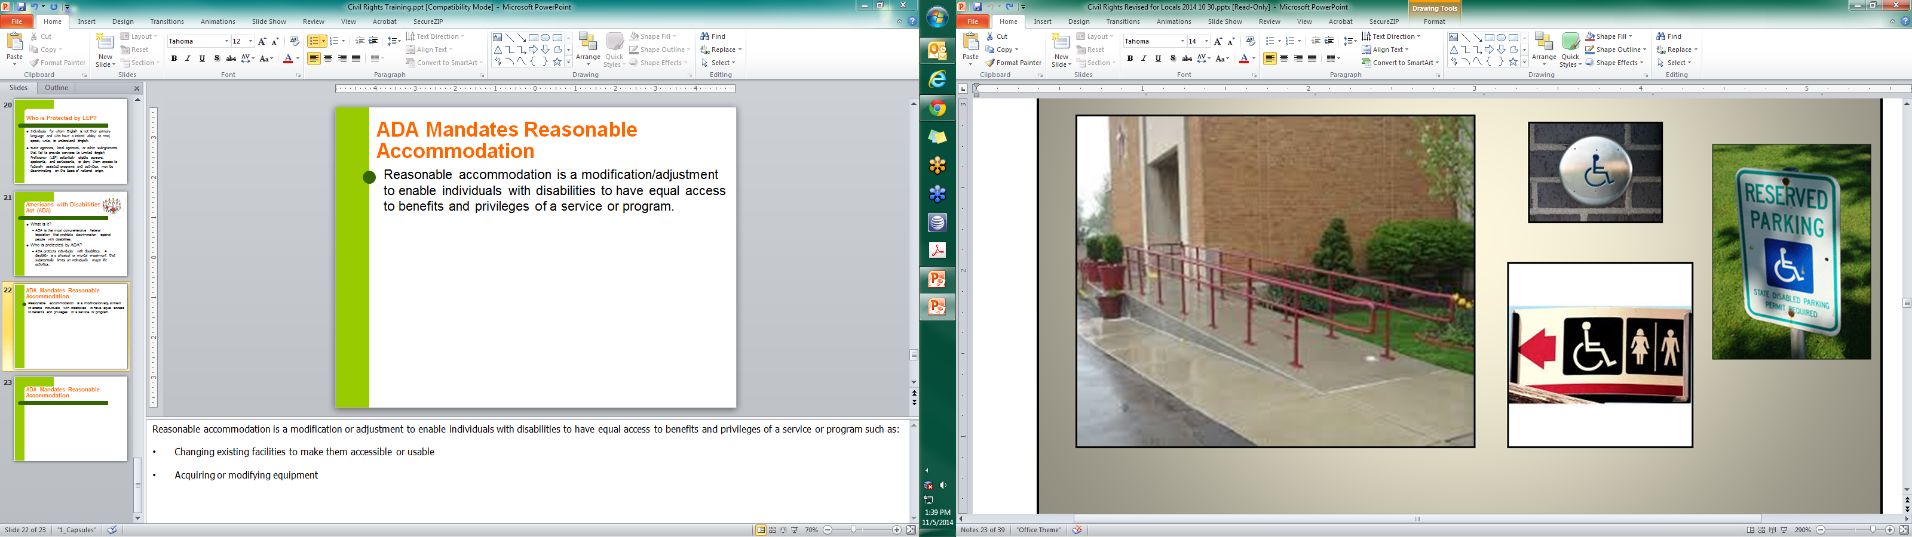
ADA Mandates Reasonable Accommodation
Reasonable accommodation is a modification/adjustment to enable individuals with disabilities to have equal access to benefits and privileges of a service or program.
Notes:
What is a reasonable accommodation?
A modification or adjustment to enable individuals with disabilities to have equal access to benefits and privileges of a service or program such as:
Changing existing facilities to make them accessible or usable
Acquiring or modifying equipment
Some examples might be:
Providing chairs,
Giving out numbers and then calling them up when ready,
Reminding them that an alternate can pick up for them
Good communication is especially important because a reasonable accommodation doesn’t always mean that applicants/participants get exactly what they request. The goal of a reasonable accommodation is to provide the same level of service to applicants/participants in an alternative way..

Slide 31




Equal Opportunity for Faith Based Organizations
Religious art, icons, scriptures or other religious symbols
CANNOT include prayer during food distribution
Prayer must occur at a different time and/or location than the food distribution
Federal funds
Notes:
Faith-based organizations
Do not have to remove religious art, icons, scriptures or other religious symbols from their distribution sites
CANNOT include or require prayer during food distribution
Prayer must occur at a different time and/or location than the food distribution
Faith-based organizations cannot use federal funds to preach their faith, support religious activities such as worship or religious instruction, or require applicants/participants to participate in their faith-related activities in order to receive program benefits.
QUESTION – SHOULD WE INCLUDE THE SIGNAGE REQUIRED THAT WE DISCUSS IN EFAP TRAINING

Slide 32
Civil Rights Reviewed
Compliance Reviewed during:
Administrative Review
Complaint Investigation
As needed
Notes:
The State will review civil rights compliance during:
Administrative Reviews
Complaint Investigations
As Needed
.

Slide 33
Civil Rights Review Verifies
Civil Rights training for staff
Complaint procedures are in place
“And the Justice For All” Poster displayed
Nondiscrimination statement on material
Reasonable accommodations
Material in appropriate language
Notes:
The review will verify:
Availability of civil rights information
If the agency and site have complaint procedures in place
If the poster is displayed
And If the nondiscrimination statement is included on all program materials
If materials are available in the appropriate language
If the complaint procedures are properly followed
If reasonable accommodations are provided to clients with disabilities
And that Front line staff and Food Bank Program Staff are receiving annual training.
Non front line staff are those that have infrequent contact with participants and require training every three years

Slide 34

Resolution of Noncompliance
If noncompliance is indicated, corrective action must be taken immediately to achieve voluntary compliance.
Notes:
What is noncompliance?
A factual finding that any civil rights requirement, as provided by law, regulation, policy, instruction, or guidelines, is not being adhered to by a State agency, sub recipient agency, or local site.
When a finding of noncompliance is found, steps must be taken immediately to obtain voluntary compliance.

Slide 35
Sample Scenario #1
A person in a wheelchair complains that the site where he was told to pick up his food package is not accessible to public transportation.
Question: What steps could be taken in this situation? How can this person be accommodated?
Answer: Offer home delivery services options and appointing a proxy
Notes:
Scenario:
A person in a wheelchair complains that the site where he was told to pick up his food package is not accessible to public transportation.
Question: What steps could be taken in this situation? How can this person be accommodated?
Answer: Offer home delivery services options and appointing a proxy.

Slide 36
Sample Scenario #2
A participant tries to speak with a volunteer at a CSFP or TEFAP distribution site in a language other than English, but the volunteer cannot understand the participant. The participant leaves without being served.
Question: How should that situation have been handled by the volunteer?
Answer: Some agencies and sites have commonly used phrases printed on cards to help with communication.
Notes:
A participant tries to speak with a volunteer at a CSFP or TEFAP distribution site in a language other than English, but the volunteer cannot understand the participant. The participant leaves without being served.
Question: How should that situation have been handled by the volunteer?
Answer: Some agencies and sites have commonly used phrases printed on cards which are available.

Slide 37
Sample Scenario #3
A reviewer from the State visits a CSFP or TEFAP distribution site and sees the And Justice For All poster displayed in the manager’s office, which is located in an area that is off limits to program applicants and participants.
Question: Is this a Civil Rights violation? Why or why not?
Answer: Yes, this is a Civil Rights violation.
Notes:
A reviewer from the State visits a CSFP or TEFAP distribution site and sees the And Justice For All poster displayed in the manager’s office, which is located in an area that is off limits to program applicants and participants.
Question: Is this a Civil Rights violation? Why or why not?
Answer: Yes, this is a Civil Rights violation. Per regulations, the “And Justice For All” poster must be prominently located where program applicants and participants can view it. This is because the poster advises applicants and participants on how to file a complaint of discrimination if they wish to do so.

Slide 38
Civil Rights Resources
USDA Civil Rights
  https://www.fns.usda.gov/civil-rights
The current nondiscrimination statement
“And Justice for All” posters supplied by CSFP and TEFAP

Slide 39

Congratulations!
Notes:
Congratulations! This concludes our annual civil rights training for today. I would like to thank you for attending this mandatory training.

Slide 40
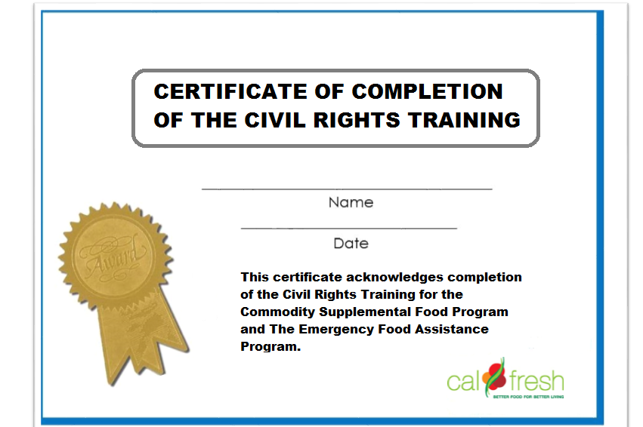
Certificate of Completion
http://www.cdss.ca.gov/inforesources/EFAP/Policies-and-Notices
Notes:
Once you complete the Civil Rights training, you MUST PROVIDE a copy of this certificate to the Food Bank. Go back to the CA Dept of Social Services website and print a copy of this certificate. Give the certificate to the Food Bank and the Food Bank must keep the certificate on file for 3 years plus the current year.
http://www.cdss.ca.gov/inforesources/EFAP/Policies-and-Notices
Again, thank you and have a great day.

